Slide 1
AssaAbloy Frame Detection POC- Customer Run-off
Dan McGuire visit Oct 18, 2022

Slide 2
Short Notes:
Frame processing- discussed the stack Lights, sensor trigger, image capture, and frame movement. Simplified Process sheet was discussed. (Slide 2- Also Word file attached)
Discussed the need for more data to tune the algorithms efficiency. Dan suggested 10 more frames to be build with defects and sent. Two of these would be of different color for a specific customer (BSC).
Strike side and hinge side defined and numbering set. (See Slide 4)Frames will be run through in this orientation.
Frist priority would be to detect the frame angle deviation.(inward or outward-</> 90 degrees.(Slide 5)
A tablet to display results was discussed. Screen to display what corner is out of square (Slide 4)
Red/Green result stack light took more than 35 seconds, which is not acceptable. Clarified that this will improve when the server moves from India to USA host.
Future improvements: to identify frame a bar code scanner integration was discussed. Dan to provide the current bar code reader used at the plant.
Question Dan asked: How do we build intelligence in a LIVE Production Operation?

Slide 3
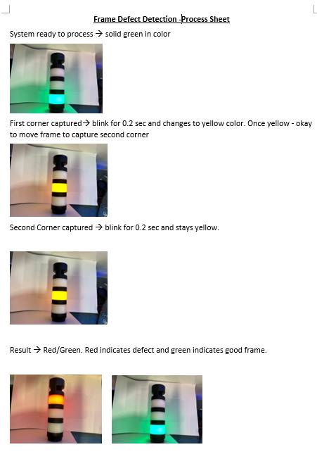

Slide 4
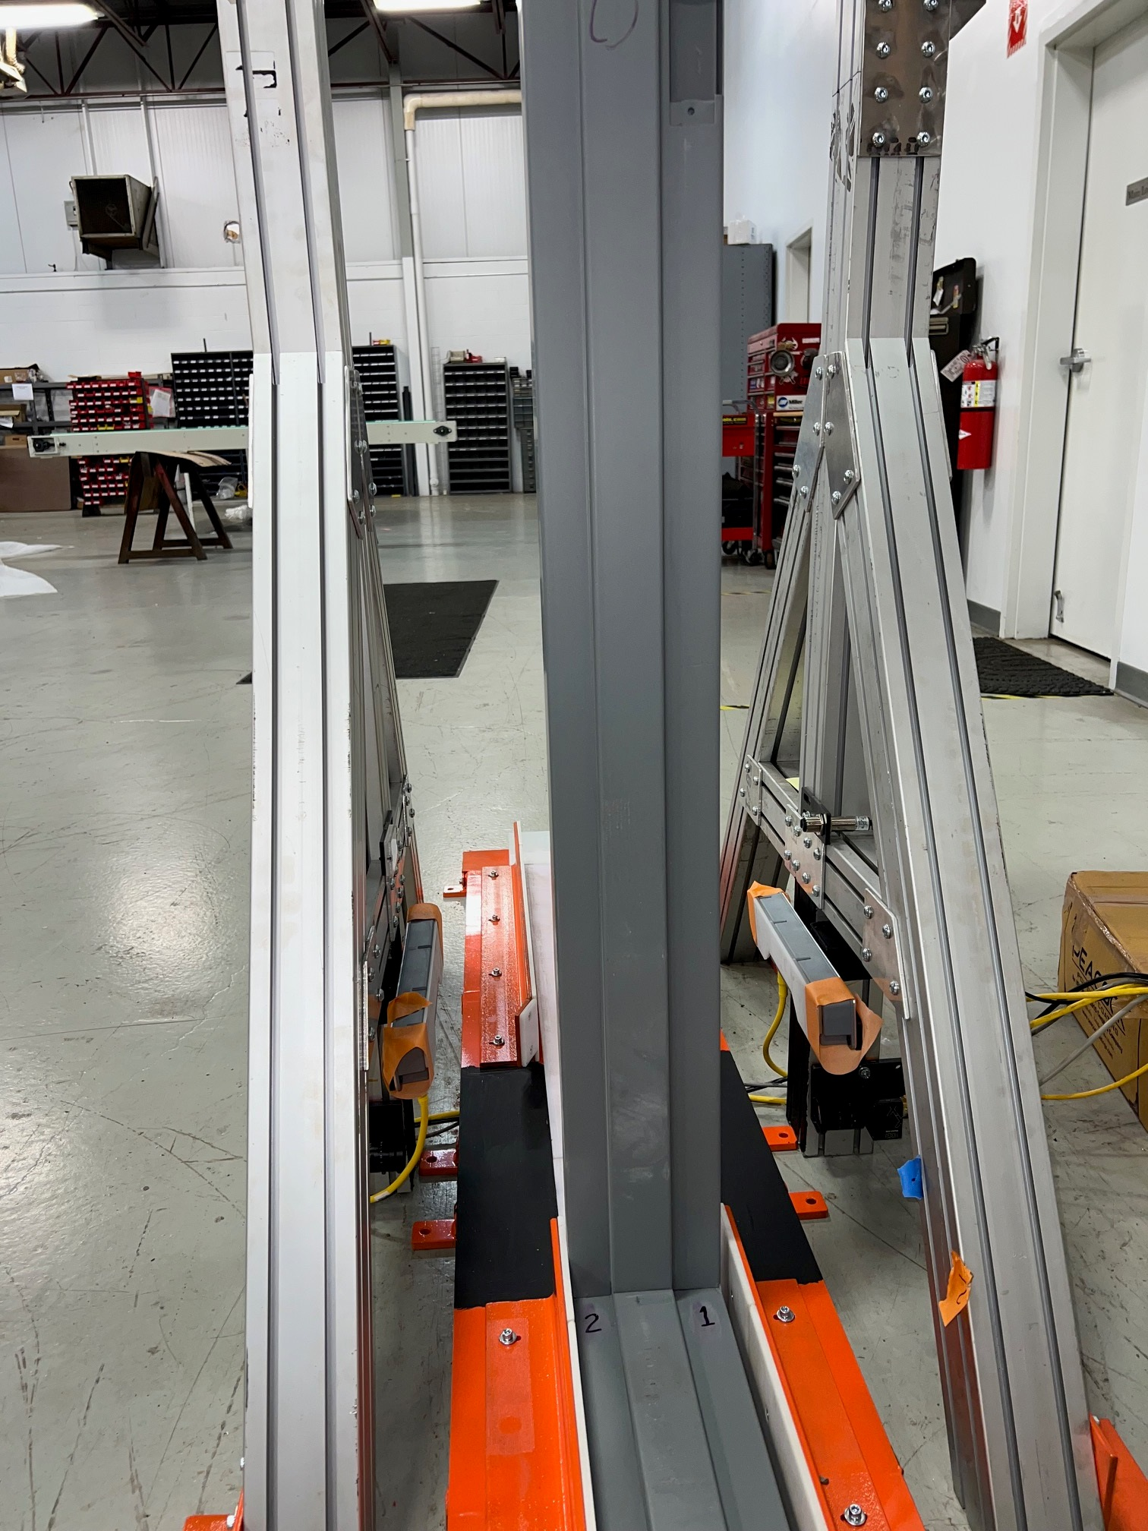
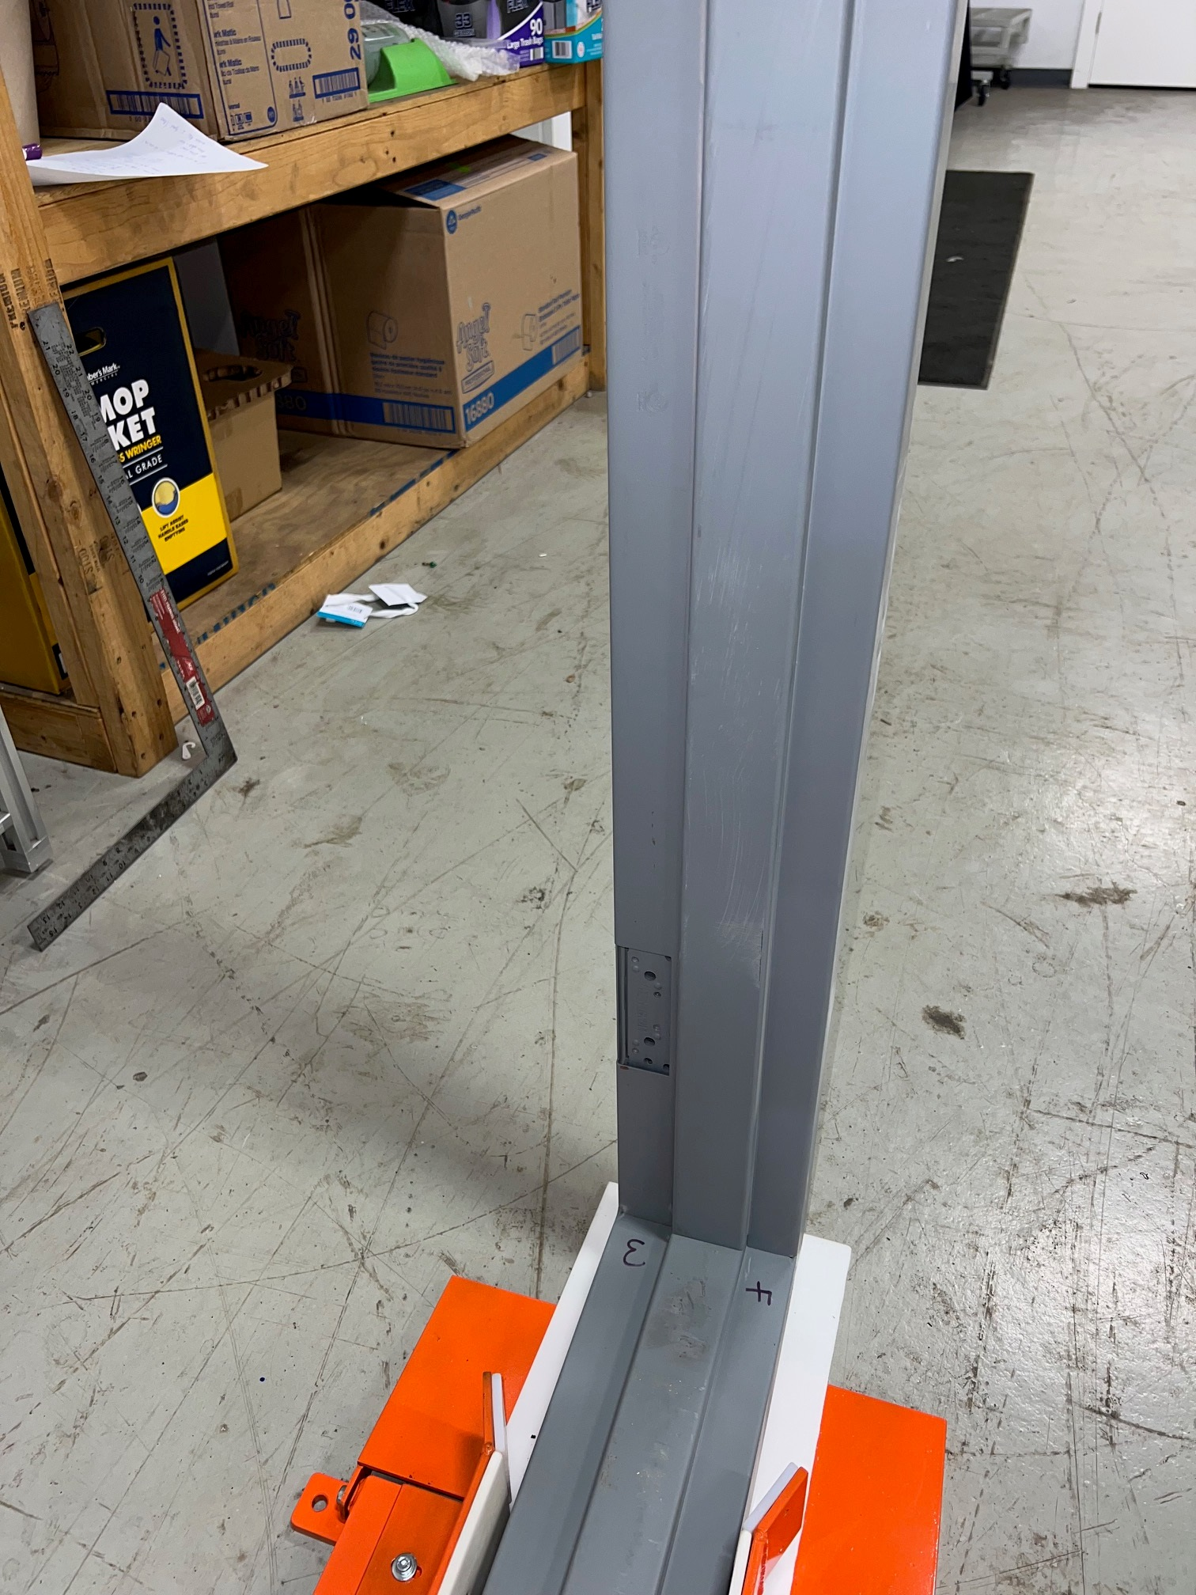
Rabbit
Strike Side
Run Frame – Direction – Strike Jamb First
Corner (1)- Strike Rabbit to Head
Corner (2)-Rabbit to head opposite Strike
Corner (3)-Hinge Rabbit to head
Corner (4)-Rabbit to head Opposite Head
Hinge Side
Head

Slide 5
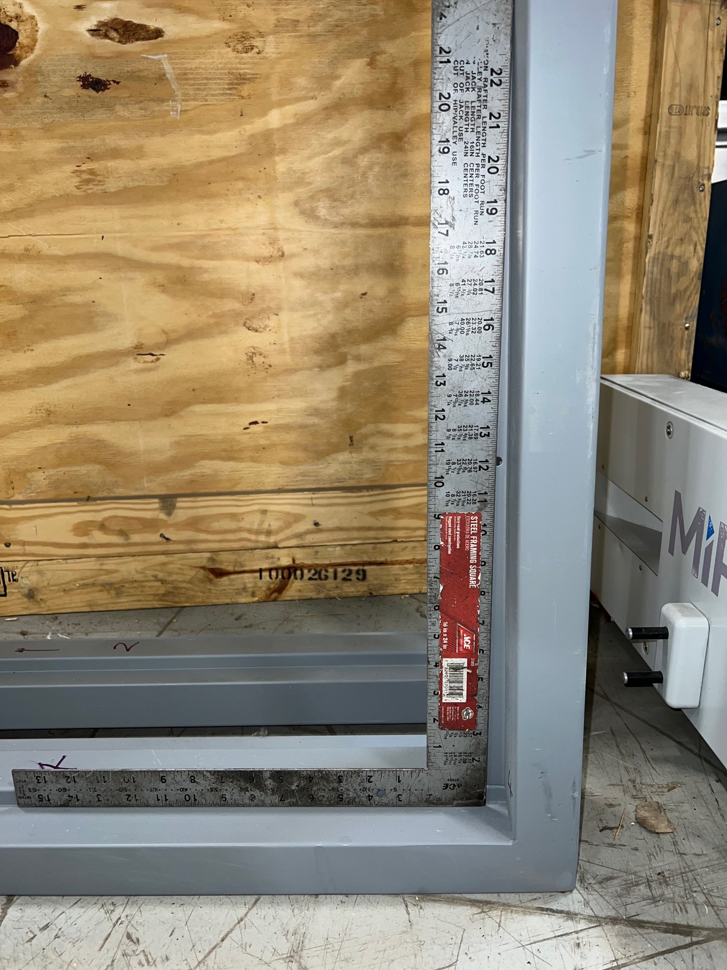
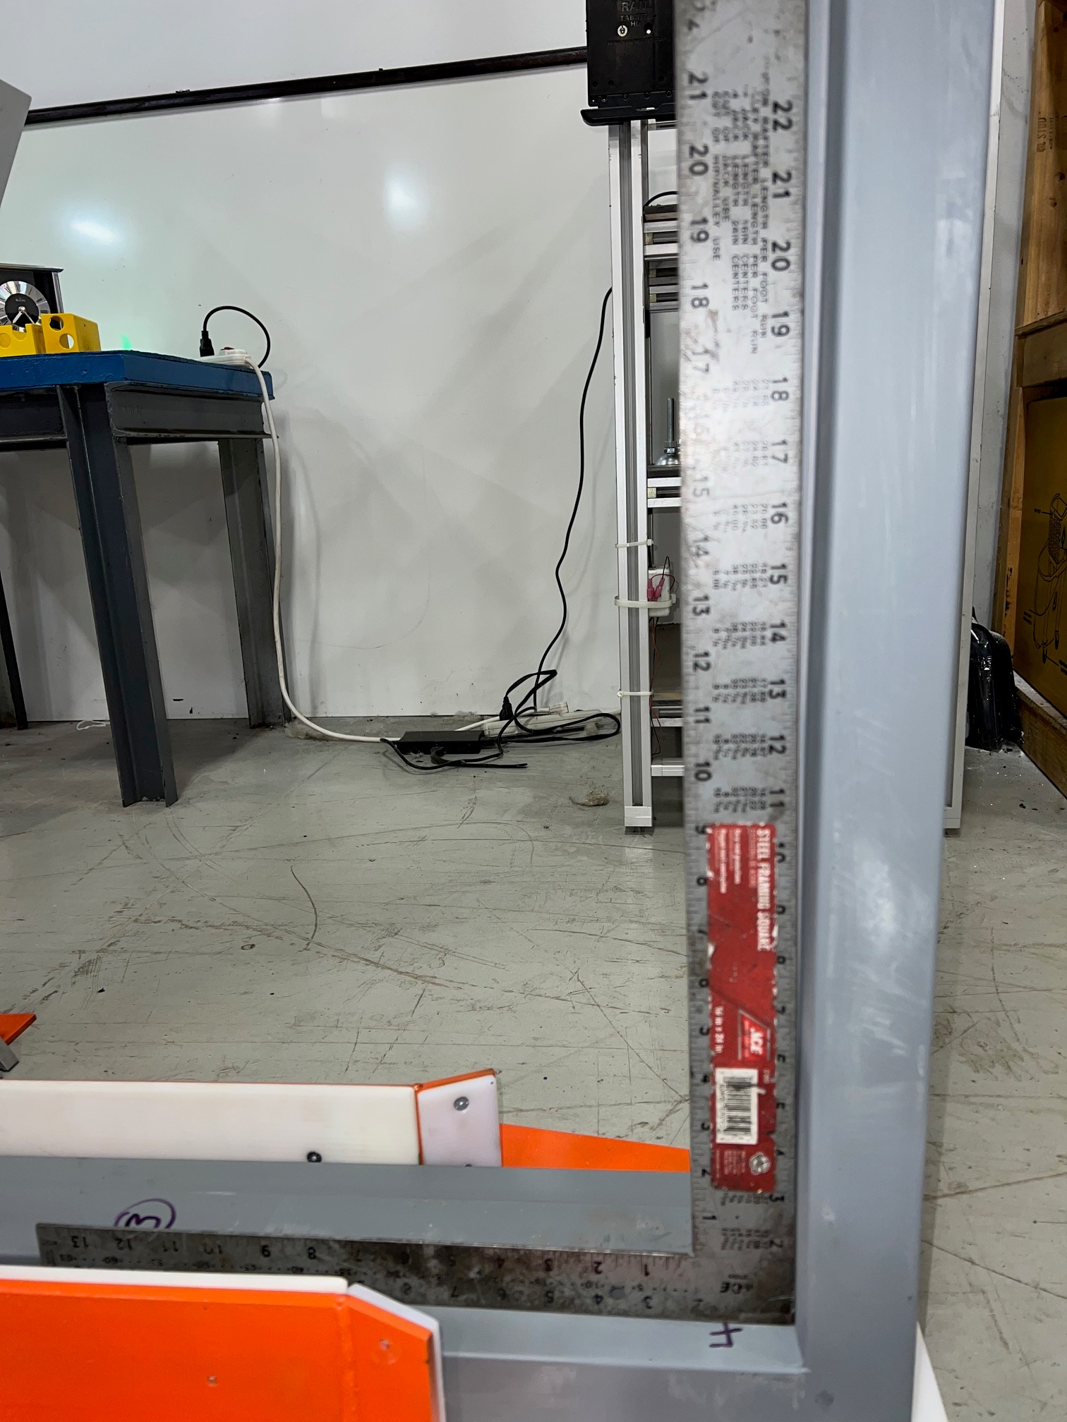
Inward
Outward
Determine Square
(1)Hinge Jamb to Head- Door side
(2)Strike side to Head-Door Side
Corner (1) and (3) are Most
Important for Square

